Slide 1
GE2262 Business Statistics Topic 2 Basic Probability Reference Levine, D.M., Krehbiel, T.C. and Berenson, M.L., Business Statistics: A First Course, Pearson Education Ltd, Chapter 4

Slide 2
Outline
Basic Probability Concepts
Conditional Probability
Counting Rules

Slide 3
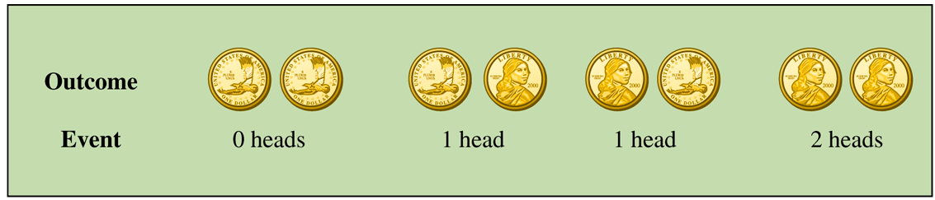
Basic Probability Concepts – Outcomes and Events
An outcome is the most basic possible results of observations or experiments
Each possible outcome or combination of outcomes of a variable is an event
Consider a toss of 2 coins and count the number of heads:
There are 4 different ways the coins could fall, i.e. there are 4 possible outcomes for the 2-coin toss
Suppose we are interested only in the number of heads, i.e. there are 3 possible events: 0 heads, 1 head and 2 heads

Slide 4
Basic Probability Concepts – Outcomes and Events
Cont’d
Simple event – an event described by a single characteristic
E.g. A day in January from all days in 2015
Joint event – an event described by two or more characteristics
E.g. A day in January that is also a Wednesday from all days in 2015
Complement of an event A (denoted A’) – all events that are not part of event A
E.g. All days in January that is not a Wednesday in 2015

Slide 5
Basic Probability Concepts – Sample Space
Sample space is the collection of all possible outcomes
E.g.
All 6 faces of a die
Full deck of playing cards

Slide 6
Basic Probability Concepts – Visualizing Events
Contingency table
Decision tree
 | Ace | Not Ace | Total
Black | 2 | 24 | 26
Red | 2 | 24 | 26
Total | 4 | 48 | 52
Sample Space
2
24
2
24
Ace
Black Card
Not an Ace
Full Deck
of Playing Cards
Ace
Red Card
Sample Space
Not an Ace

Slide 7
Basic Probability Concepts – Exercise
Cont’d
A sample of 1,000 households were asked about their intentions to purchase a large-screen HDTV sometime during the next 12 months. The same 1,000 households were surveyed 12 months later to see whether they purchased a television. The results are:
What is the sample space?
Give examples of simple event and joint events.
Planned to Purchase | Actually Purchased
 | Yes | No | Total
Yes | 200 | 50 | 250
No | 100 | 650 | 750
Total | 300 | 700 | 1000

Slide 8
Basic Probability Concepts – Exercise
Cont’d
Sample space:
Simple events are:
Joint events are:

Slide 9
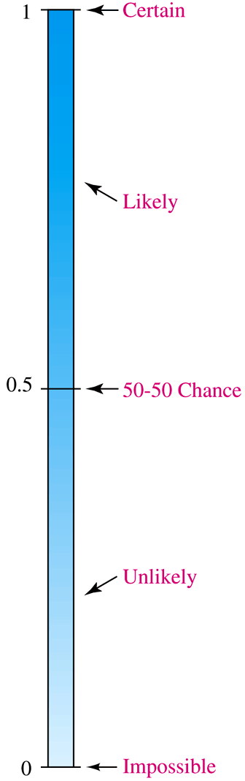
Basic Probability Concepts
Probability is the numerical value representing the chance, likelihood, or possibility that a particular event will occur
Its value is between 0 and 1, inclusive
Impossible event – an event that has no chance of occurring (probability = 0)
Certain event – an event that is sure to occur (probability = 1)
0 ≤ P(A) ≤ 1 for any event A

Slide 10

Assessing Probability
There are 3 possible approaches to assessing the probability of an event A
A priori – based on prior knowledge of the process
Empirical probability
Subjective probability
P(A) = $\frac{X}{T}=\frac{number of ways the event can occur }{total number of possible outcomes}$
Assuming all outcomes are equally likely
P(A) = $\frac{number of times the event occurred }{total number of observations}$
based on a combination of an individual’s past experience, personal opinion, and analysis of a particular situation

Slide 11
Assessing Probability
Cont’d
Example of prior probability: What is the probability of getting 1 head in a toss of two coins?
P(Getting 1 head) = 2 / 4 = 0.5

Slide 12
Assessing Probability
Cont’d
Example of empirical probability: Refer to the 1,000 households interviewed for the intention of buying a HDTV. What is the probability of selecting a household that planned to purchase a large-screen HDTV in the next 12 months?
Planned to Purchase | Actually Purchased
 | Yes | No | Total
Yes | 200 | 50 | 250
No | 100 | 650 | 750
Total | 300 | 700 | 1000
P(Planned to purchase) = 250 / 1000 = 0.25

Slide 13
Assessing Probability
Cont’d
The assignment of a subjective probability is based on a person’s experiences, opinions, and analysis of a particular situation
It may differ from person to person
It is useful in situations when an empirical or a priori probability cannot be computed
Example: A media development team assigns a 60% probability of success to its new ad campaign, but the chief media officer of the company is less optimistic and assigns a 40% of success to the same campaign

Slide 14
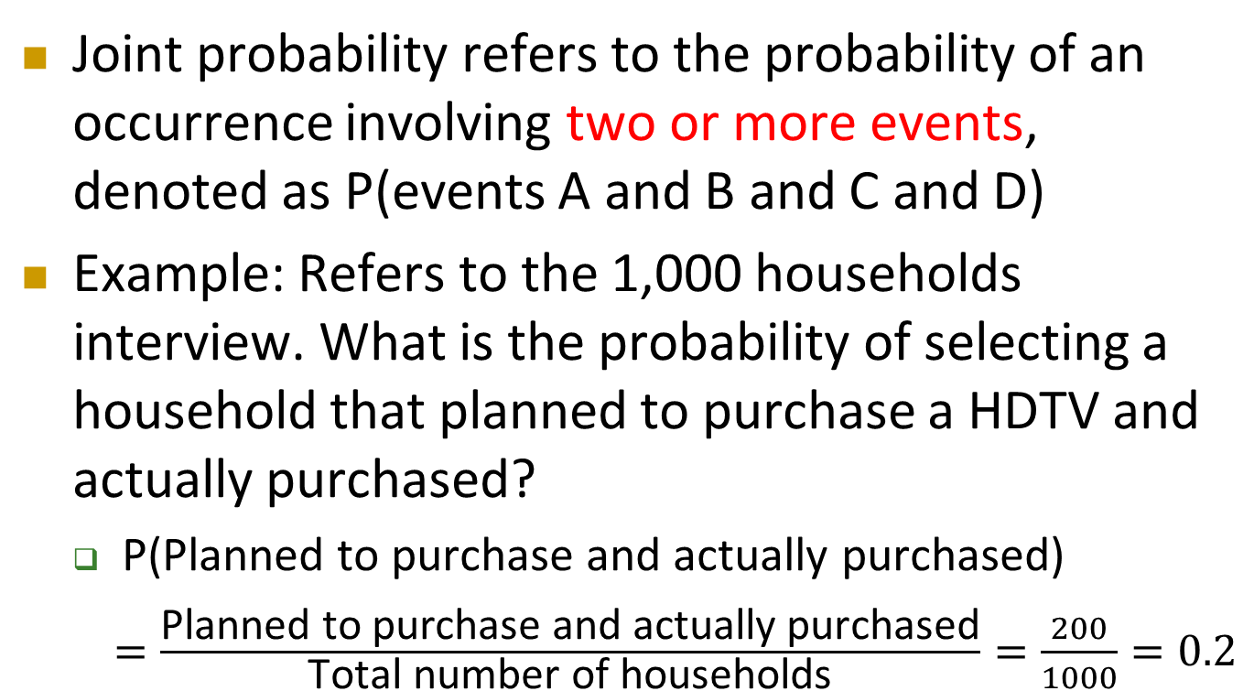
Joint Probability
Joint probability refers to the probability of an occurrence involving two or more events, denoted as P(events A and B and C and D)
Example: Refers to the 1,000 households interview. What is the probability of selecting a household that planned to purchase a HDTV and actually purchased?
P(Planned to purchase and actually purchased)
$=\frac{\text{Planned} \text{to} \text{purchase} \text{and} \text{actually} \text{purchased}}{\text{Total} \text{number} \text{of} \text{households}}=\frac{200}{1000}=0.2$

Slide 15
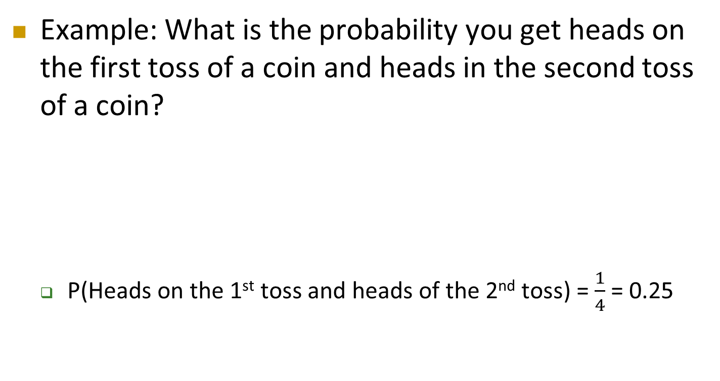
Joint Probability
Cont’d
Example: What is the probability you get heads on the first toss of a coin and heads in the second toss of a coin?
P(Heads on the 1st toss and heads of the 2nd toss) = $\frac{1}{4}$ = 0.25
1st Toss
2nd Toss
1st Toss
2nd Toss
1st Toss
2nd Toss
1st Toss
2nd Toss

Slide 16
Marginal Probability
Marginal probability is the probability of the occurrence of the single event (simple probability)
It is often derived from summing up all possible joint events that involves the concerned event
Formal definition
P(A) = P(A and B₁)+P(A and B₂)+……+P(A and B_{k})
where B_{1,} B_{2, …….,} B_{k} are mutually exclusive and collectively exhaustive events

Slide 17
Marginal Probability
Cont’d
The events are mutually exclusive if they cannot occur simultaneously
If events A and B are mutually exclusive, P(A and B) = 0
Example:
Events A and B are mutually exclusive
A = queen of diamonds B = queen of clubs

Slide 18
Marginal Probability
Cont’d
A set of events is collectively exhaustive if one of the events must occur, and the set of events cover the whole sample space
If event A and B are mutually exclusive and collective exhaustive, P(A)+P(B) = 1
Example:
Events A, B, C and D are collectively exhaustive but not mutually exclusive as an ace may also be a heart
Events B, C and D are collectively exhaustive and also mutually exclusive
A = aces B = black C = diamonds D = hearts

Slide 19
Marginal Probability
Cont’d
Example: Refer to the 1,000 households interviewed for the intention of buying a HDTV
P(Planned to purchase)
= P(Planned to purchase and actually purchased) +
P(Planned to purchase and did not actually purchased)
= 0.2 + 0.05 = 0.25
Planned to Purchase | Actually Purchased
 | Yes | No | Total
Yes | 200 | 50 | 250
No | 100 | 650 | 750
Total | 300 | 700 | 1000

Slide 20
General Addition Rule
The probability of either event A or event B occurs is denoted as P(A or B) and is defined as
P(A or B) = P(A) + P(B) – P(A and B)
If A and B are mutually exclusive events, the rule is simplified as
P(A or B) = P(A) + P(B)

Slide 21
General Addition Rule
Cont’d
Example: Refer to the 1,000 households interviewed for the intention of buying a HDTV
P(Planned to purchase or actually purchased)
= P(Planned to purchase ) + P(Actually purchased) –
P(Planned to purchase and actually purchased)
= 0.25 + 0.30 – 0.20 = 0.35
Planned to Purchase | Actually Purchased
 | Yes | No | Total
Yes | 200 | 50 | 250
No | 100 | 650 | 750
Total | 300 | 700 | 1000

Slide 22
Conditional Probability
A conditional probability is the probability of one event, given that another event has occurred
Symbolically, conditional probability of event A given event B is denoted as P(A|B)
P(A|B) may or may not equal to P(A), it depends on the relationship between the two events

Slide 23
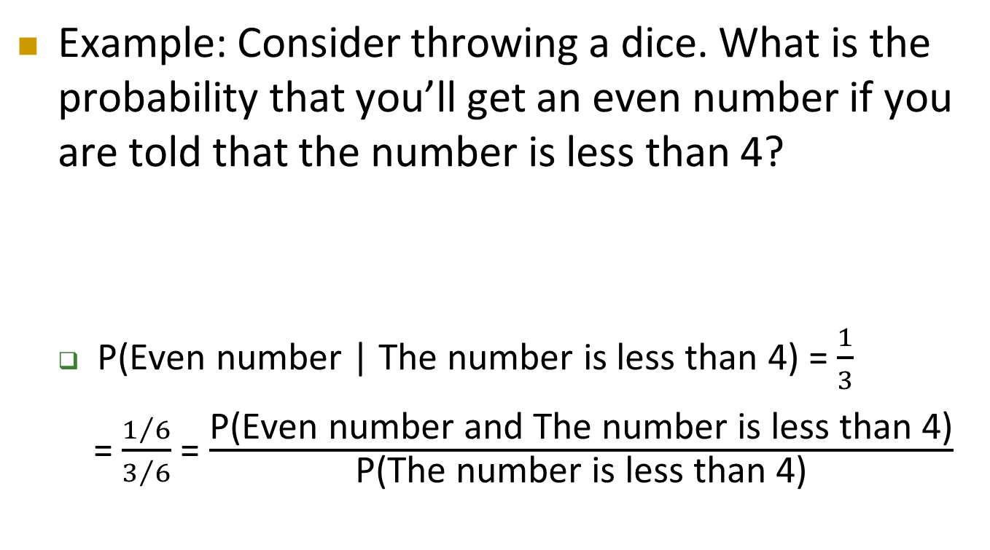
Conditional Probability
Cont’d
Example: Consider throwing a dice. What is the probability that you’ll get an even number if you are told that the number is less than 4?
P(Even number | The number is less than 4) = $\frac{1}{3}$
=$\frac{1/6}{3/6}$ = $\frac{\text{P}\text{(}\text{Even} \text{number} \text{and} \text{The} \text{number} \text{is} \text{less} \text{than}\text{ 4)}}{\text{P}\text{(}\text{The} \text{number} \text{is} \text{less} \text{than}\text{ 4)}}$

Slide 24
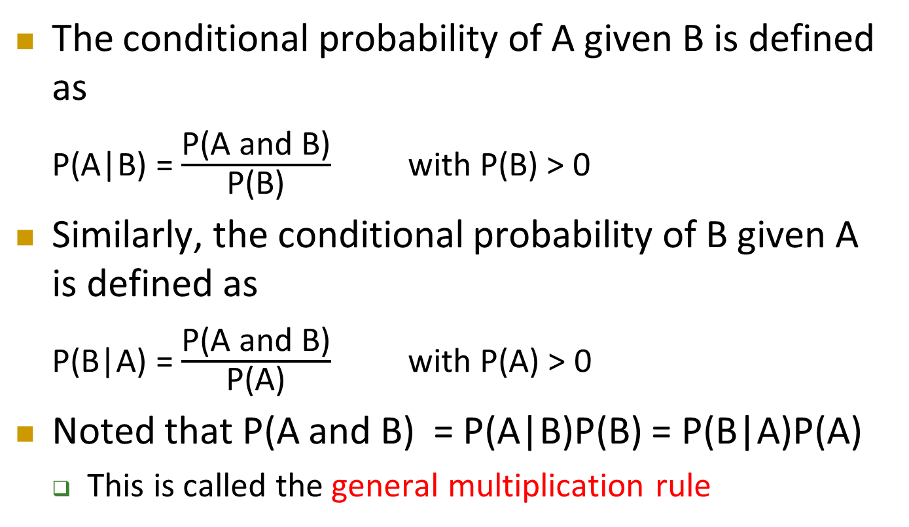
Conditional Probability
Cont’d
The conditional probability of A given B is defined as
P(A|B) = $\frac{\text{P}\text{(}\text{A} \text{and} \text{B}\text{)}}{\text{P}\text{(}\text{B}\text{)}}$ with P(B) > 0
Similarly, the conditional probability of B given A is defined as
P(B|A) = $\frac{\text{P}\text{(}\text{A} \text{and} \text{B}\text{)}}{\text{P}\text{(}\text{A}\text{)}}$ with P(A) > 0
Noted that P(A and B) = P(A|B)P(B) = P(B|A)P(A)
This is called the general multiplication rule

Slide 25
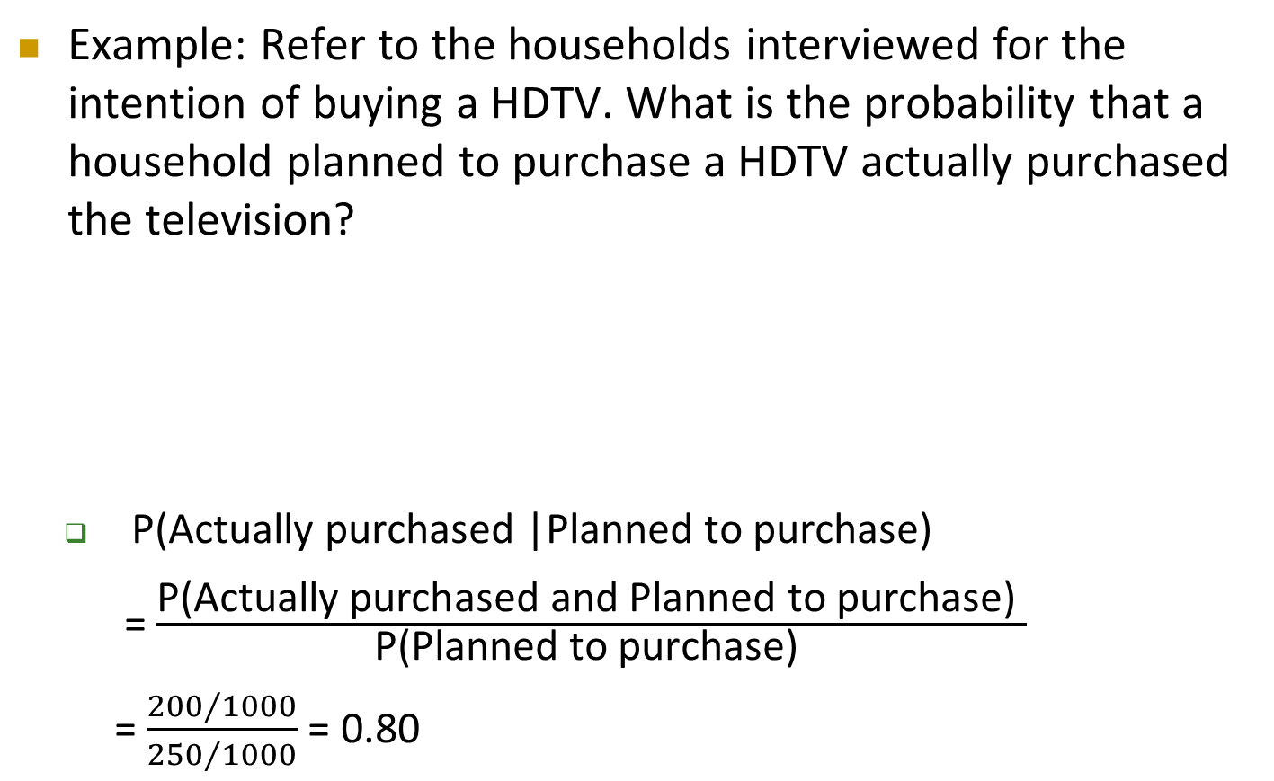
Conditional Probability
Cont’d
Example: Refer to the households interviewed for the intention of buying a HDTV. What is the probability that a household planned to purchase a HDTV actually purchased the television?
P(Actually purchased |Planned to purchase)
= $\frac{\text{P}\text{(}\text{Actually} \text{purchased} \text{and} \text{Planned} \text{to} \text{purchase}\text{) }}{\text{P}\text{(}\text{Planned} \text{to} \text{purchase}\text{) }}$
= $\frac{{200}/{1000}}{{250}/{1000}}$ = 0.80
Planned to Purchase | Actually Purchased
 | Yes | No | Total
Yes | 200 | 50 | 250
No | 100 | 650 | 750
Total | 300 | 700 | 1000

Slide 26


Conditional Probability
Cont’d
Example:
$$P\left(Red Card given that it is an Ace\right)$$
$$=P\left(Red | Ace\right)=\frac{2 Red Aces}{4 Aces}=\frac{1}{2}$$
$$=\frac{P(Red and Ace)}{P(Ace)}=\frac{2/52}{4/52}=\frac{1}{2}$$
Example:
$$P\left(Ace card given that it is Red\right)$$
$$=P\left(Ace | Red\right)=\frac{2 Red Aces}{26 Red}=\frac{1}{13}$$
$$=\frac{P(Red and Ace)}{P(Red)}=\frac{2/52}{26/52}=\frac{1}{13}$$
 | Ace | Not Ace | Total
Black | 2 | 24 | 26
Red | 2 | 24 | 26
Total | 4 | 48 | 52
 | Ace | Not Ace | Total
Black | 2 | 24 | 26
Red | 2 | 24 | 26
Total | 4 | 48 | 52
Red Ace
Ace Card
Red Ace
Red Card

Slide 27
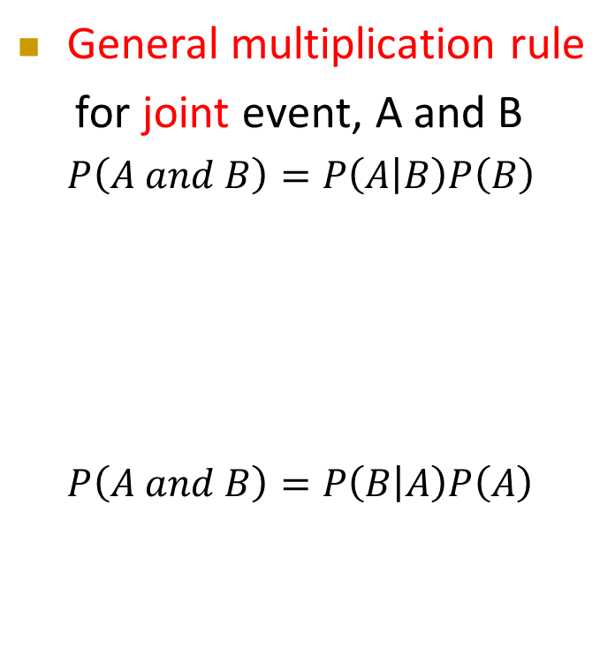
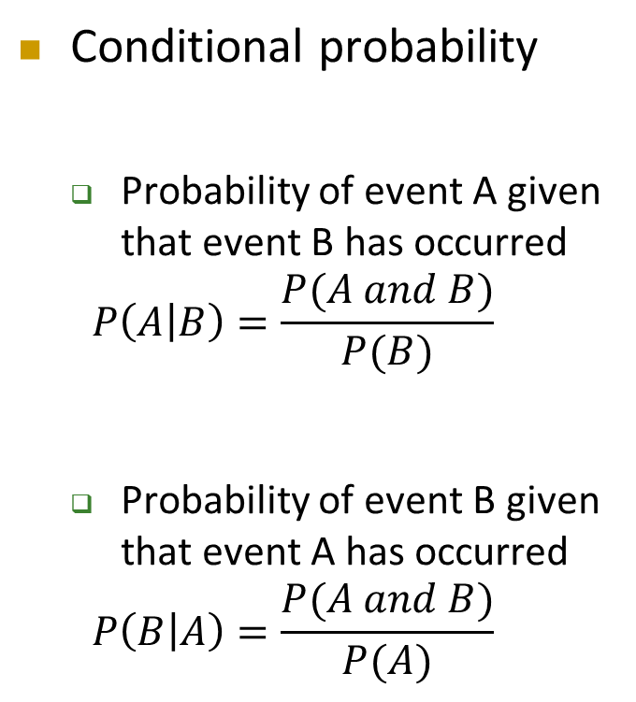


Conditional Probability
Cont’d
Conditional probability
Probability of event A given that event B has occurred
$$P\left(A | B\right)=\frac{P(A and B)}{P(B)}$$
Probability of event B given that event A has occurred
$$P\left(B | A\right)=\frac{P(A and B)}{P(A)}$$
General multiplication rule
for joint event, A and B
$$P\left(A and B\right)=P\left(A | B\right)P\left(B\right)$$
$$P\left(A and B\right)=P\left(B | A\right)P\left(A\right)$$
E.g. $P\left(Red Card and Ace\right)$
$$= P(Red|Ace)P(Ace)$$
$=$ $\frac{1}{2}×\frac{4}{52}$
$=$ $\frac{2}{52}$ = $\frac{1}{26}$
E.g. $P\left(Red Card and Ace\right)$
$$= P(Ace|Red)P(Red)$$
$=$ $\frac{1}{13}×\frac{26}{52}$
$=$ $\frac{2}{52}$ = $\frac{1}{26}$

Slide 28
Conditional Probability
Cont’d
Statistical independence
Two events, A and B, are independent if the occurrence of event A does not affect the probability of occurrence of event B, or vice versa
Two events are independent if and only if
P(A|B) = P(A) or P(B|A) =P(B)
This implies P(A and B) = P(A)P(B) if A and B are independent

Slide 29
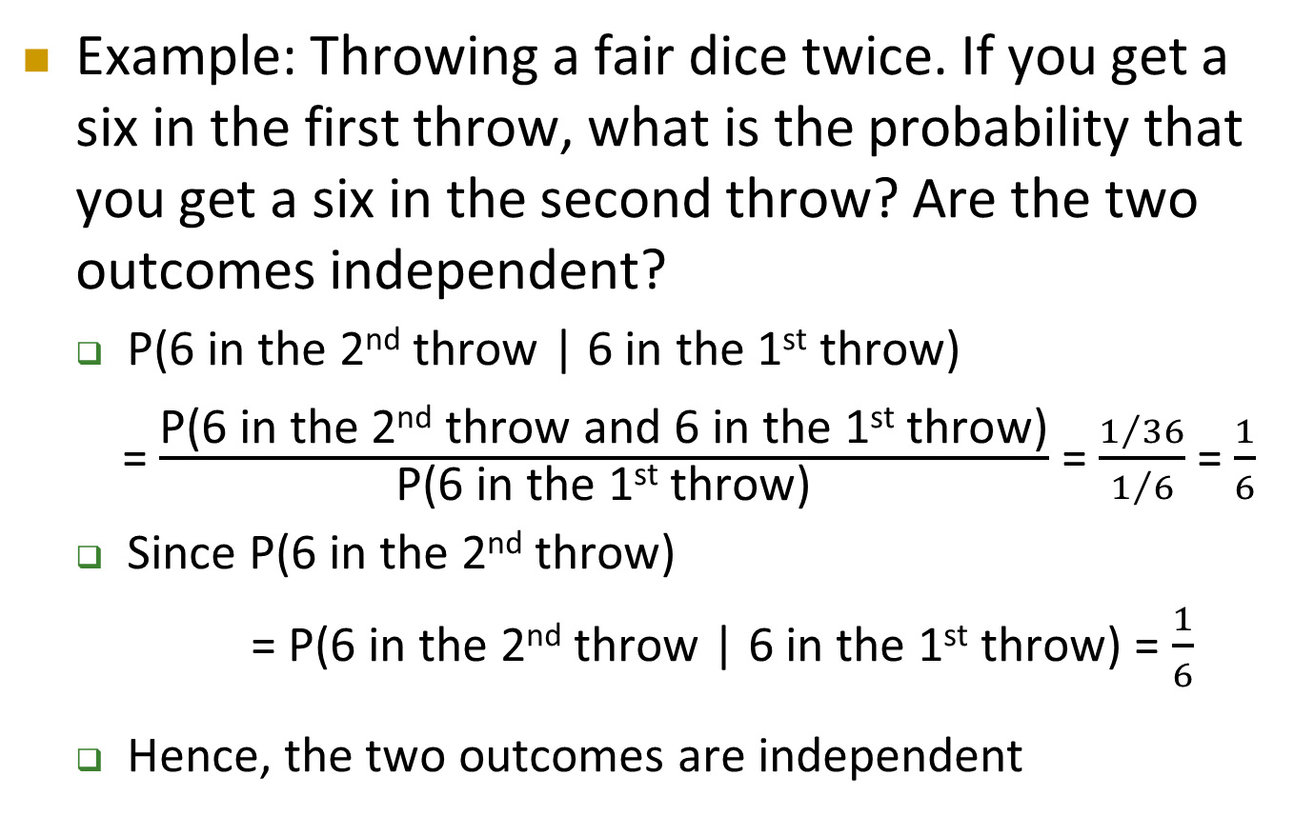
Conditional Probability
Cont’d
Example: Throwing a fair dice twice. If you get a six in the first throw, what is the probability that you get a six in the second throw? Are the two outcomes independent?
P(6 in the 2nd throw | 6 in the 1st throw)
= $\frac{\text{P}\text{(6 }\text{in} \text{the}\text{ 2}\text{nd} \text{throw} \text{and}\text{ 6 }\text{in} \text{the}\text{ 1}\text{st} \text{throw}\text{)}}{\text{P}\text{(6 }\text{in} \text{the}\text{ 1}\text{st} \text{throw}\text{)}}$ = $\frac{1/{36}}{1/6}$ = $\frac{1}{6}$
Since P(6 in the 2nd throw)
= P(6 in the 2nd throw | 6 in the 1st throw) = $\frac{1}{6}$
Hence, the two outcomes are independent

Slide 30
Conditional Probability
Cont’d
Example: Refer to the households interview data. Suppose for the 300 households that actually purchased HDTVs with either standard or faster refresh rate, the households were asked if they were satisfied with their purchases. Their responses to the question as follows:
TV Refresh Rate | Satisfied with Purchase?
 | Yes | No | Total
Faster | 64 | 16 | 80
Standard | 176 | 44 | 220
Total | 240 | 60 | 300

Slide 31
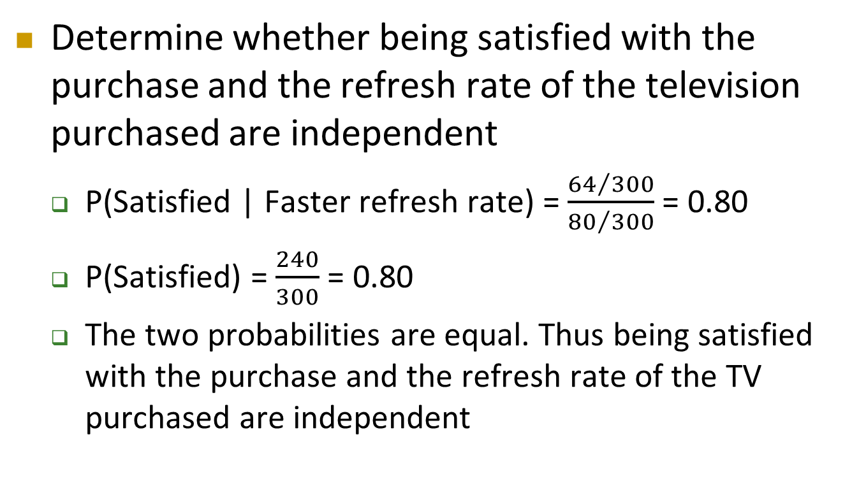
Conditional Probability
Cont’d
Determine whether being satisfied with the purchase and the refresh rate of the television purchased are independent
P(Satisfied | Faster refresh rate) = $\frac{{64}/{300}}{{80}/{300}}$ = 0.80
P(Satisfied) = $\frac{240}{300}$ = 0.80
The two probabilities are equal. Thus being satisfied with the purchase and the refresh rate of the TV purchased are independent

Slide 32
Conditional Probability – Exercise
Cont’d
A company is considering changing its starting business hour from 8am to 7:30am. The company has 1200 workers, including 450 office and 750 production workers. A census shows that 370 production workers favor the change, and a total of 715 office and production workers favor the change. Is the relationship between worker type and opinion independent?

Slide 33
Counting Rules
For a sample space with a large number of possible outcomes, counting rules can be used to compute probabilities
Counting rule 1:
If any one of k different mutually exclusive and collectively exhaustive events can occur on each of n trials, the number of possible outcomes is equal to
k^{n}
Example: If you roll a fair die 3 times then there are 6³ = 216 possible outcomes

Slide 34
Counting Rules
Cont’d
Counting rule 2:
If there are k₁ events on the first trial, k₂ events on the second trial, … and k_{n} events on the n^{th} trial, the number of possible outcomes is
(k₁)(k₂)……(k_{n})
Example: You want to go to a park, eat at a restaurant, and see a movie. There are 3 parks, 4 restaurants, and 6 movie choices. How many different possible combinations are there?
Answer: (3)(4)(6) = 72 different possibilities

Slide 35
Counting Rules
Cont’d
Counting rule 3:
The number of ways that n items can be arranged in order is
n! = (n)(n – 1)…(1)
Example: You have five books to put on a bookshelf. How many different ways can these books be placed on the shelf?
Answer: 5! = (5)(4)(3)(2)(1) = 120 different possibilities

Slide 36
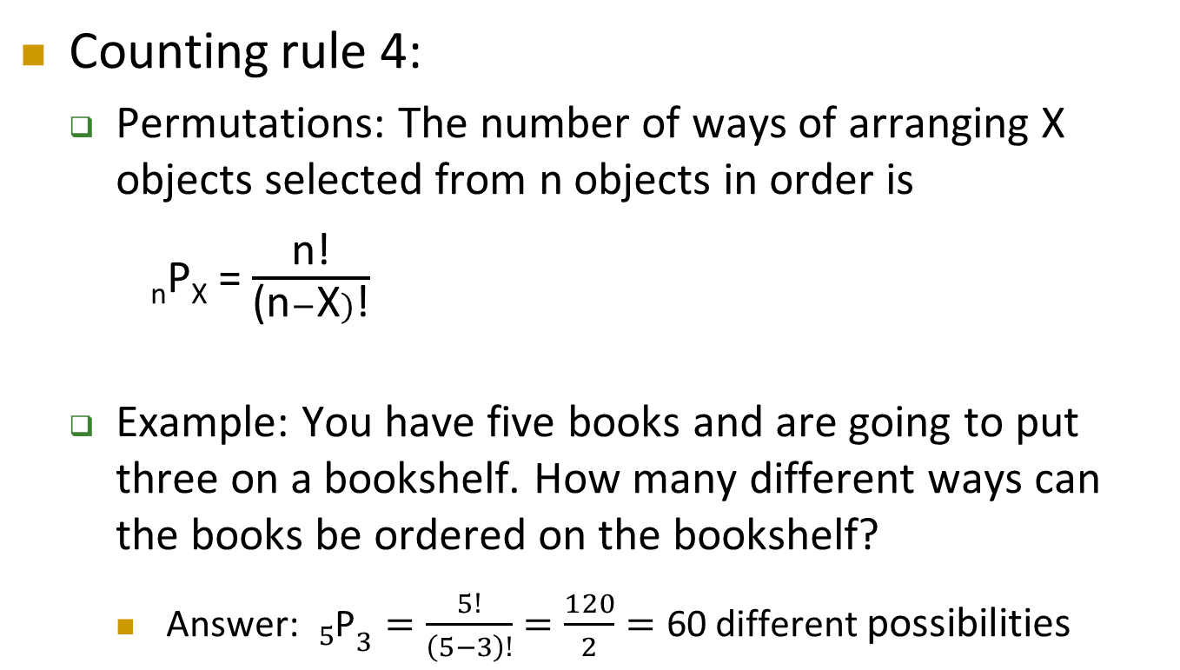
Counting Rules
Cont’d
Counting rule 4:
Permutations: The number of ways of arranging X objects selected from n objects in order is
_{n}P_{X} = $\frac{\text{n}\text{!}}{\text{(}\text{n}−\text{X})\text{!}}$
Example: You have five books and are going to put three on a bookshelf. How many different ways can the books be ordered on the bookshelf?
Answer: ${{}_{5}^{}{\text{P}}}_{3}=\frac{5!}{\left(5−3\right)!}=\frac{120}{2}=\text{60 }\text{different} \text{possibilities}$

Slide 37
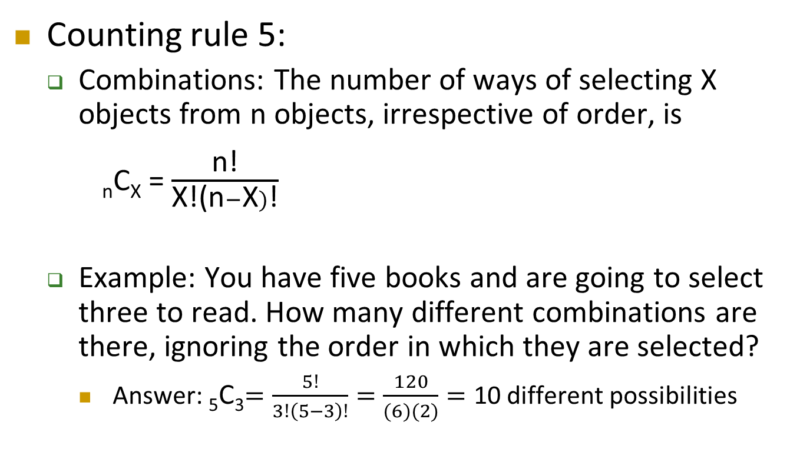
Counting Rules
Cont’d
Counting rule 5:
Combinations: The number of ways of selecting X objects from n objects, irrespective of order, is
_{n}C_{X} = $\frac{\text{n}\text{!}}{\text{X}\text{!}\text{(}\text{n}−\text{X})\text{!}}$
Example: You have five books and are going to select three to read. How many different combinations are there, ignoring the order in which they are selected?
Answer: ₅C₃$=\frac{5!}{3!\left(5−3\right)!}=\frac{120}{(6)(2)}=\text{10 }\text{different} \text{possibilities}$

